Slide 1
Department of Management
Destination Day for Admitted Students
Spring 2026

Slide 2
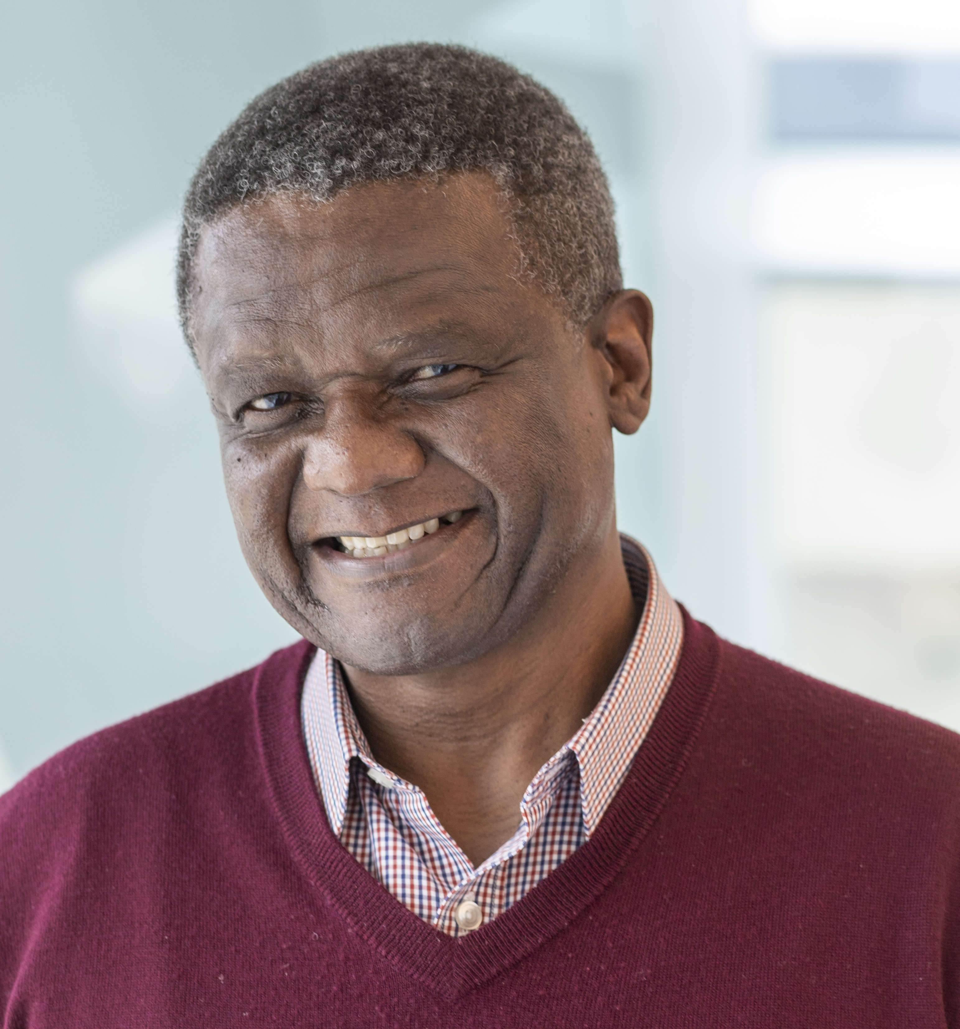
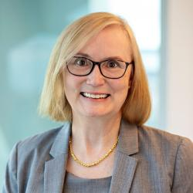
Welcome to the Management Department!
Mzamo Mangaliso
Jennifer Merton
Department Chair
Associate Chair

Slide 3
Department Structure
Dept. Chair
Organization Studies
Strategic Management
Org. Behavior, HRM
Ethics, Sustainability
Strategy, Consulting
Entrepreneurship Innovation
International Management
Assoc. Chair
Dept. Coordinator

Slide 4
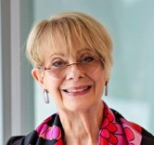
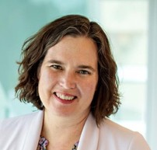
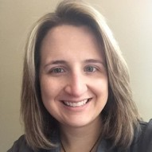
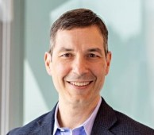
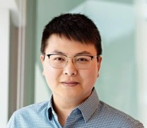
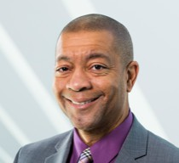
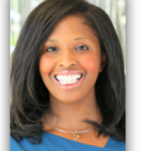
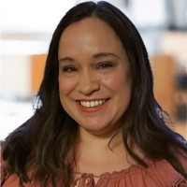
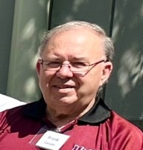
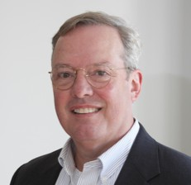
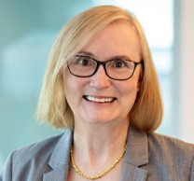
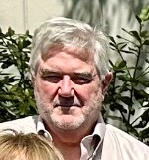
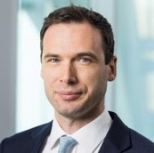
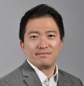
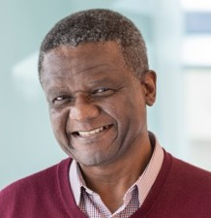
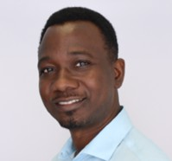
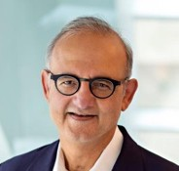
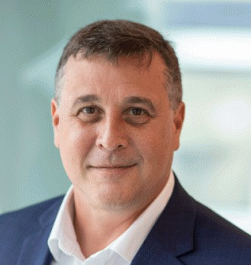

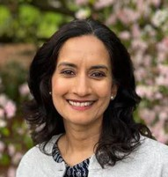
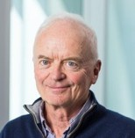
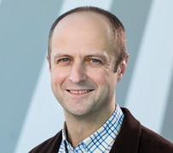
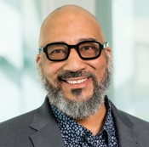
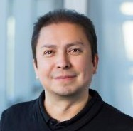
Management Faculty by Area
Org. studies
Marta Calás
Emily Heaphy
Jennifer Gephart
Joe Labianca
Feng Qiu
Orlando Richard
Adaora Ubaka
Law/Org Dev.
Nicki Amos
Frank Caruso
Matt Langenkamp
Jennifer Merton
Brian Shea
Strategy
Michael Blomfield Honggi Lee Mzamo Mangaliso
Bruce Skaggs
Ulya Tsolmon
Tope Oladimeji
Anurag Sharma
Innov./Entrep.
Gregory Thomas
Carlos Valladares
Ina Ganguli Charlie Johnson Bogdan Prokopovych
Notes:
Innovation/Entrepreneurship/Sustainability
Ethics/Law/Leadership/Org. Development

Slide 5
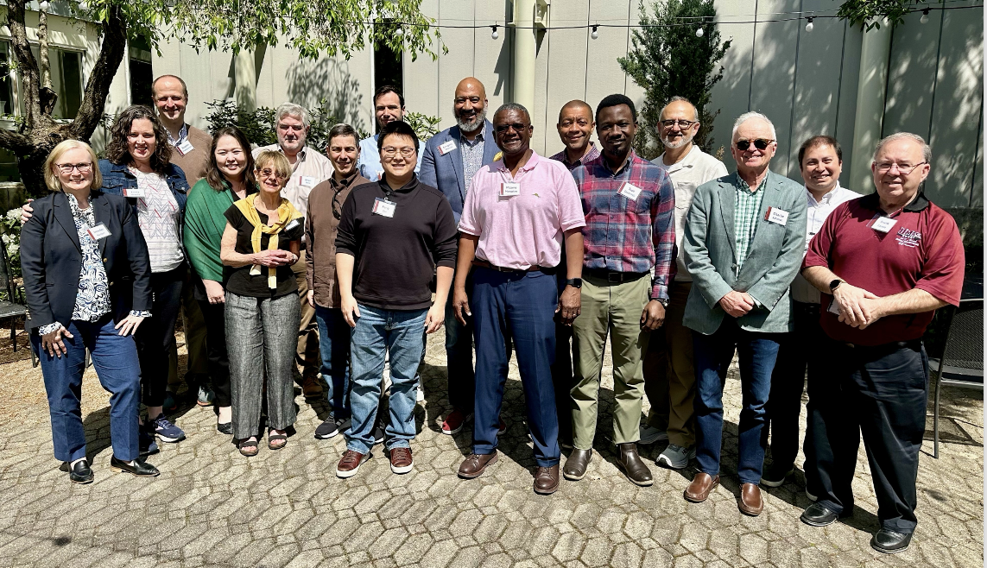
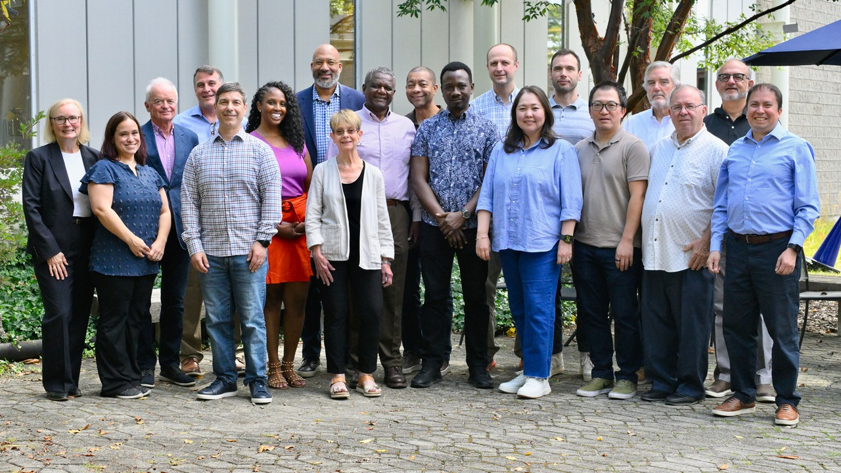

Management Dept. Retreat, Willits-Hallowell Conference Center, South Hadley, MA
May 2024
September 2025
Back L-R: Bogdan Prokopovych, Brian Shea, Michael Blomfield, Gregory Thomas, Orlando Richard, Anurag Sharma, Carlos Valladares
Front L-R: Jennifer Merton, Emily Heaphy, Ulya Tsolomon, Marta Calás, Joe Labianca, Feng Qiu, Mzamo Mangaliso, Tope Oladimeji, Charlie Johnson, Frank Caruso
Back L-R: Charlie Johnson, Bruce Skaggs, Gregory Thomas, Orlando Richard, Bogdan Prokopovych, Michael Blomfield, Brian Shea, Anurag Sharma
Front L-R: Jennifer Merton, Nicki Amos, Joe Labianca, Adaora Ubaka, Marta Calás, Mzamo Mangaliso, Tope Oladimeji, Ulya Tsolomon, Honggi Lee, Frank Caruso, Carlos Valladares

Slide 6
Our Department’s Vision
To be known as leaders in the creation of knowledge that greatly impacts management practice and theory

Slide 7
Critical thinking reflexivity, to transform organizations
Theory building to impact policy decisions
Knowledge creation, innovation, and entrepreneurship
Different methodological approaches
Research in the broad areas of management
Transnationality, ethics, social responsibility
Mission
Management practices that affect society
Social Entrepreneurship Environmental Sustainability

Slide 8
What the Major Teaches
Skills, techniques for effective management
Culture, behavior, and international management
Decision-making, ethics, and morality
Strategic planning & mgmt entrepreneurship
Organizational structure & design
Leadership, motivation, communication
HRM, managing workforce diversity
Control, technology and change implementation
Management Consulting strategies

Slide 9

Management Department Information Session Spring 2026

Slide 10
Management Major
Provides the knowledge and skills necessary for managing change in complex organizations
An excellent choice for combining with a complementary field or concentration
Great foundation for graduate studies
Management Department Information Session Spring 2025

Slide 11

Management Courses
Focus on the management of change in four distinct areas:
The Changing Social, Political, and Economic Context
Evolving Workplace Dynamics
Organizational Formation and Transformation
Globalization
Management Department Information Session Spring 2026

Slide 12

Areas of Concentration
Sustainable Business Practices
Entrepreneurship and Innovation Management
Human Resource Management
Management Department Information Session Spring 2025

Slide 13


Sustainable Business Practices
Threats to the sustainability of the global economy
Environmental & social impacts of business
Ability to promote, achieve social change
Balance economic gains vs. social & environmental outcomes
Management Department Information Session Spring 2025

Slide 14

Entrepreneurship & Innovation Management
Learn how to analyze the risks and rewards of a business opportunity
How to anticipate the obstacles that must be overcome in starting and managing a new venture
Obtain skills and resources required for successful promotion of innovation
Learn how to diagnose and solve problems in small business organizations
Management Department Information Session Spring 2025

Slide 15


Human Resource Management
Focus on effective management of people within organizations
  Recruitment
  Hiring
  Training
  Compensation
  Performance Evaluation
And … societal factors that impact HR activities
  Laws
  Regulations
  Unions
  Economic Conditions
  Composition of the Work Force
Management Department Information Session Spring 2026

Slide 16

Potential Areas of Focus
International Management
Personalized Focus

Slide 17

International Management
Understanding the interconnectedness of the world as it pertains to management
Understanding issues at a global level
Learn what makes management in other cultures work
Learn to adopt an exploratory attitude
Sharpen your analytical skills
Management Department Information Session Spring 2025

Slide 18
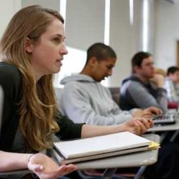
Personalized Focus
Use your electives to tailor the degree to fit your career goals.
Take courses from anywhere in the university.
Past examples include:
  Biotech Management
  Agribusiness Management
  Theater Management
  Non-profit Management
  Law

Slide 19
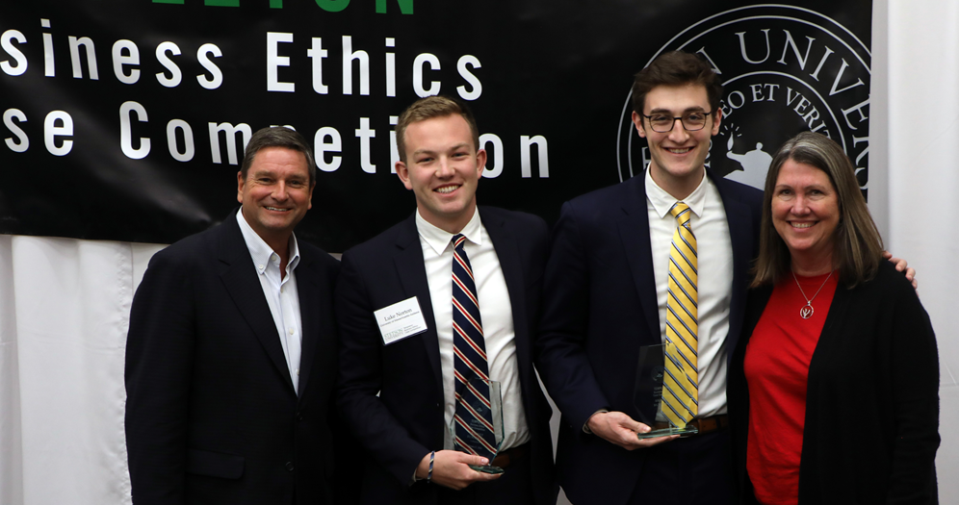
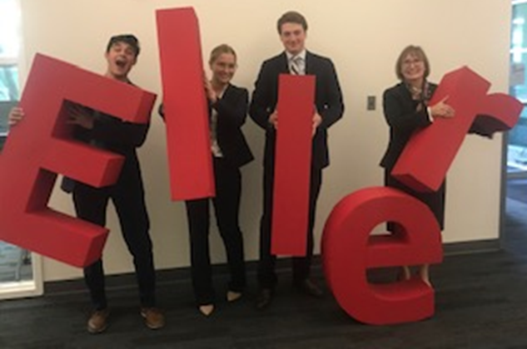
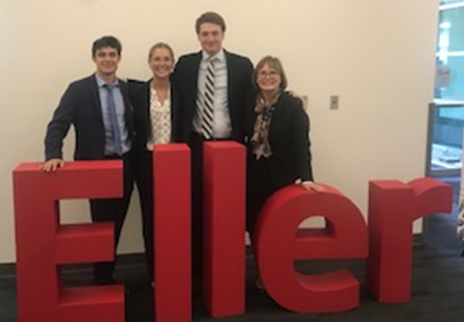
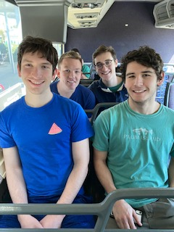
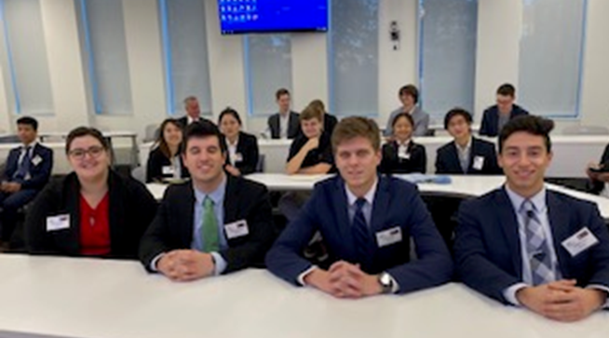
Extra-Curricular Activities in Isenberg
Isenberg Ethics Competition

Slide 20

Isenberg Management Association
Involvement, Leadership, and Networking Opportunities
Game Theory Night
Strategy Competition
Ethical Frameworks
Discussion and Debate Night
Art of Negotiations
Alumni & Recruiters
CapSim Strategy Competition

Slide 21

Outstanding Internship Opportunities
Amazon
National Grid
Target
Staples
Goldman Sachs
ING
Enterprise Rent-a-Car
Northwestern Mutual
GE Capital
Liberty Mutual
Bridgestone/Firestone
Utilize the Chase Career Center!

Slide 22
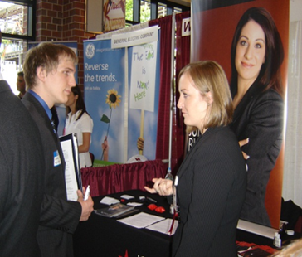
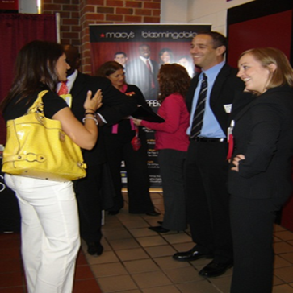
Exposure to Top Industry Recruiters
Companies Hiring Recent Management Major Graduates:
Raytheon Amicus Therapeutics Insight Global
ING Cisco Systems Google
DataDog Enterprise Macy’s
MGM Fidelity Investment AT&T
Liberty Mutual JM Scanlon Staples
Hanover Insurance Abercrombie & Fitch TJX
Hartford Financial Marriot Target
FBI State Street Bank Oracle
Utilize the Chase Career Center!

Slide 23
Office Phone #: 413-545-8096
Mzamo Mangaliso: mangaliso@isenberg.umass.edu
Jennifer Merton: jfmerton@isenberg.umass.edu
Kristin Edmonds: kedmonds@isenberg.umass.edu

